Slide 1
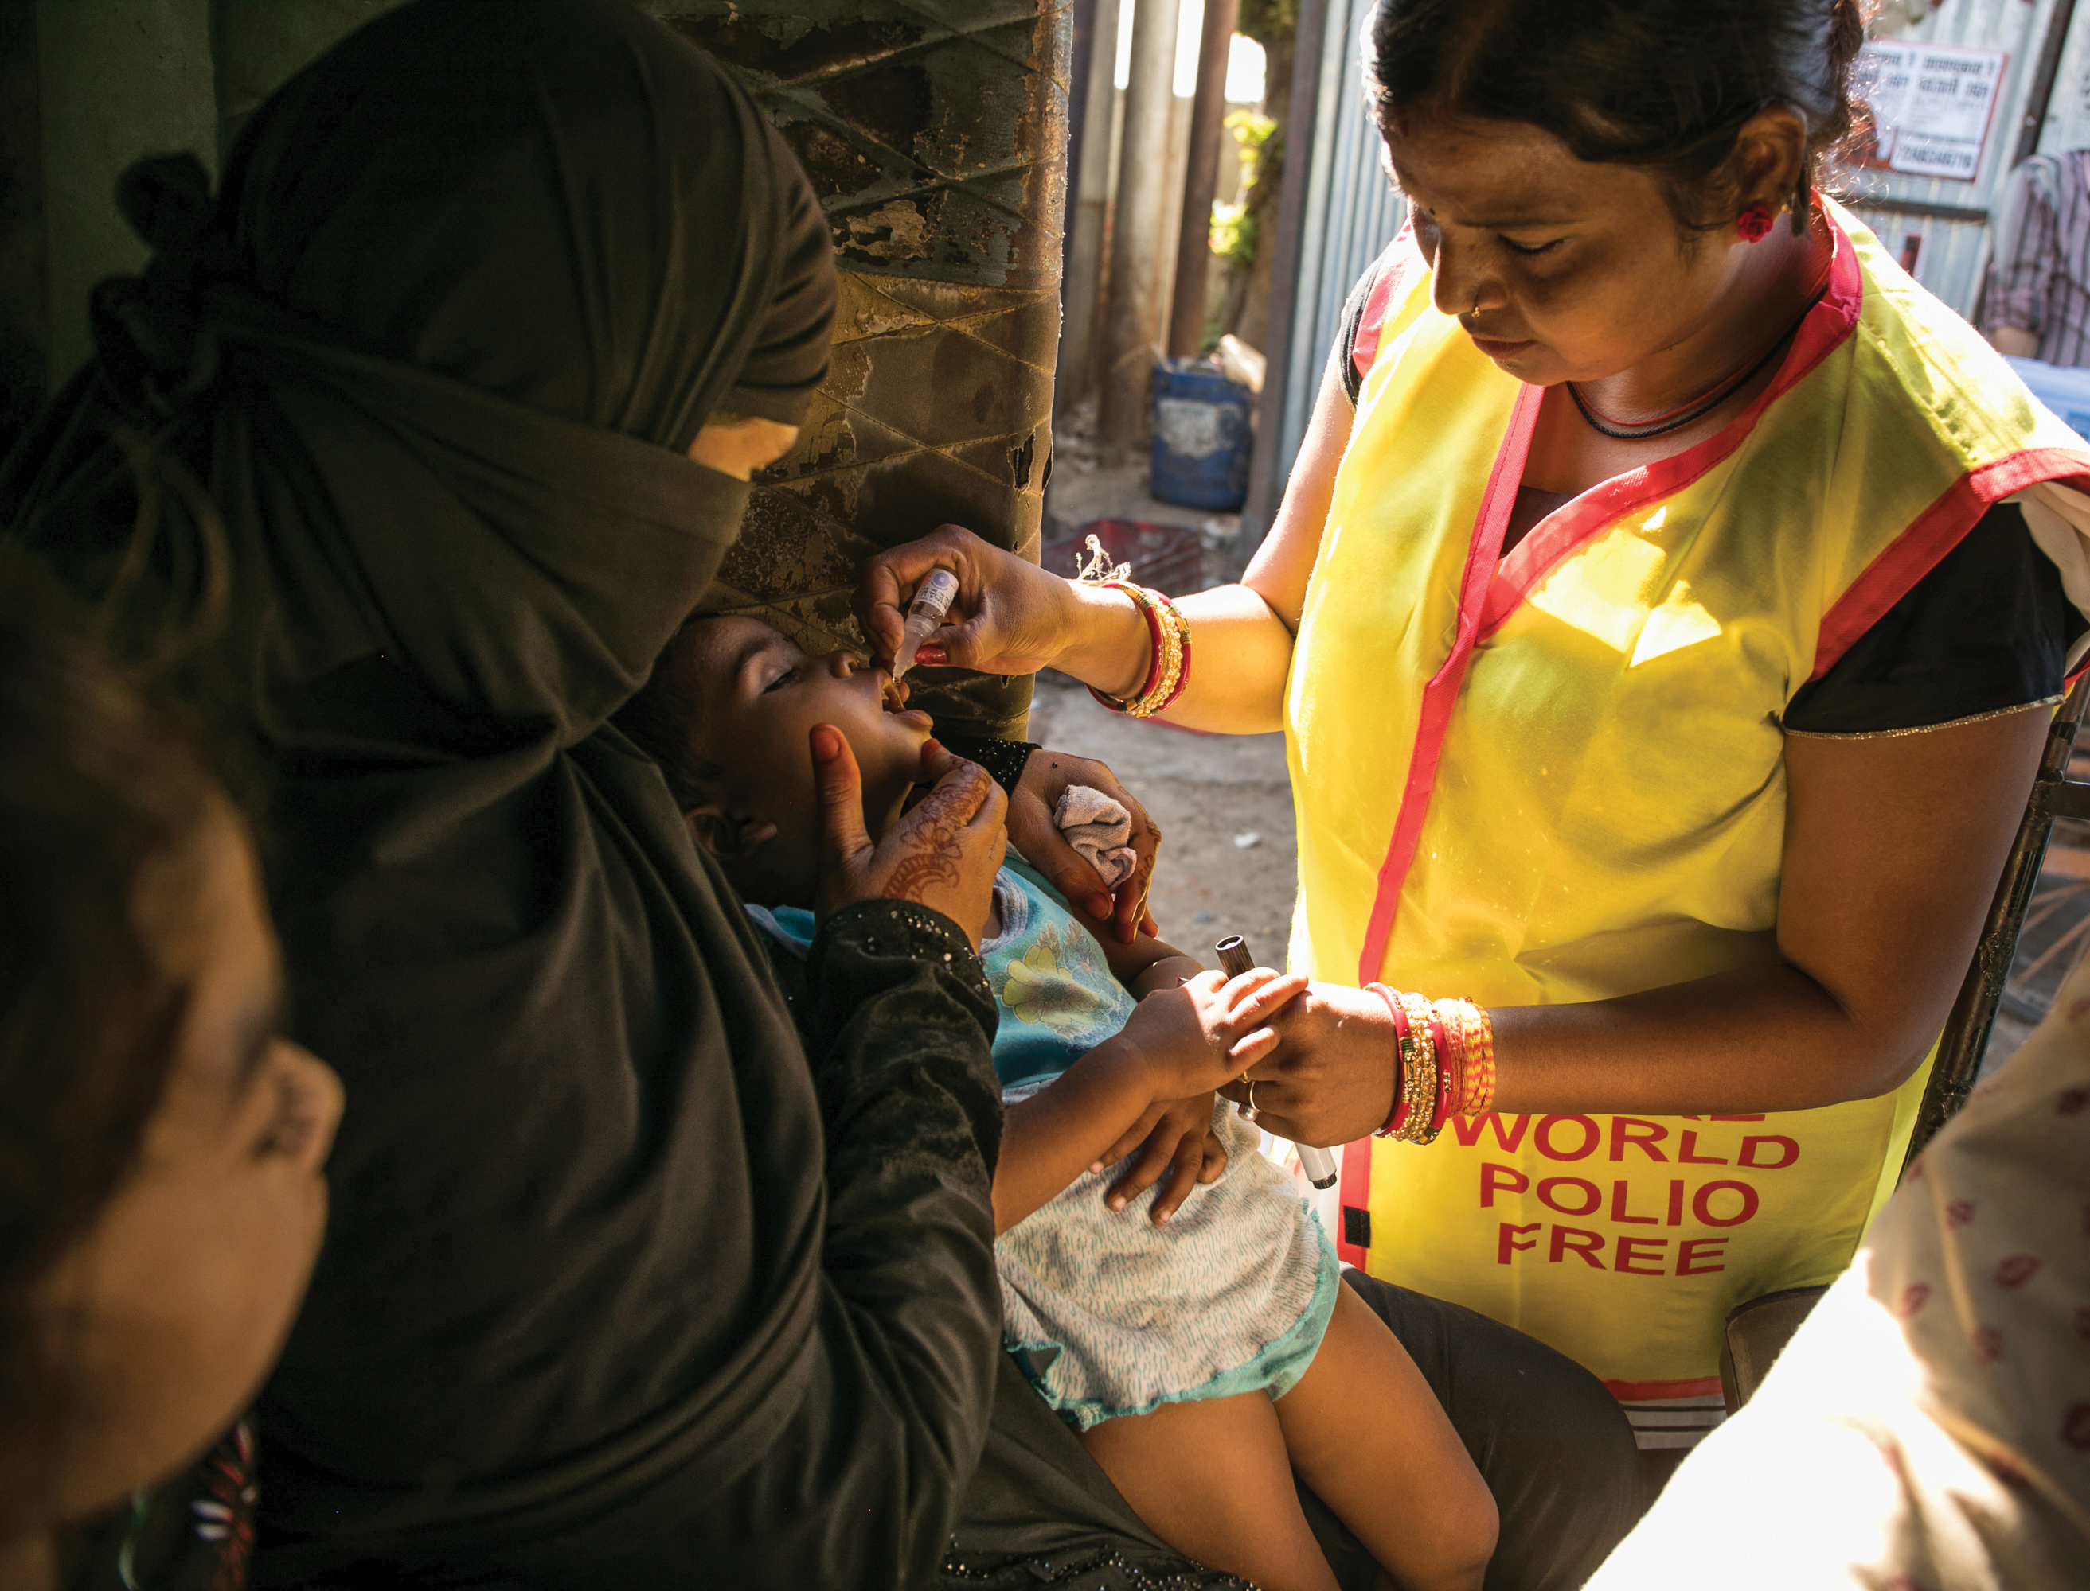
TOGETHER,
WE END
POLIO

Slide 2
WHAT IS POLIO?
A highly infectious disease
Spread person to person
Asymptomatic or mild flu-like symptoms
Can cause paralysis or death
There is no cure
…but it is preventable
Notes:
Poliomyelitis (a.k.a. poliovirus) – a highly infectious disease that most commonly affects children under 5 years old.
In the word Poliomyelitis – the first portion Polio refers to the Enterovirus which invades intestines via contaminated water, Myel refers to the myelin of the nerves which causes nerve damage at different levels and itis refers to inflammation.
Spread person to person, typically through contaminated water.
Most people who contract polio may be asymptomatic or show mild flu-like symptoms.
Can cause paralysis or death in some people. There is no cure once you acquire the virus.
There is no cure.
…but it is preventable with a safe and effective vaccine.

Slide 3
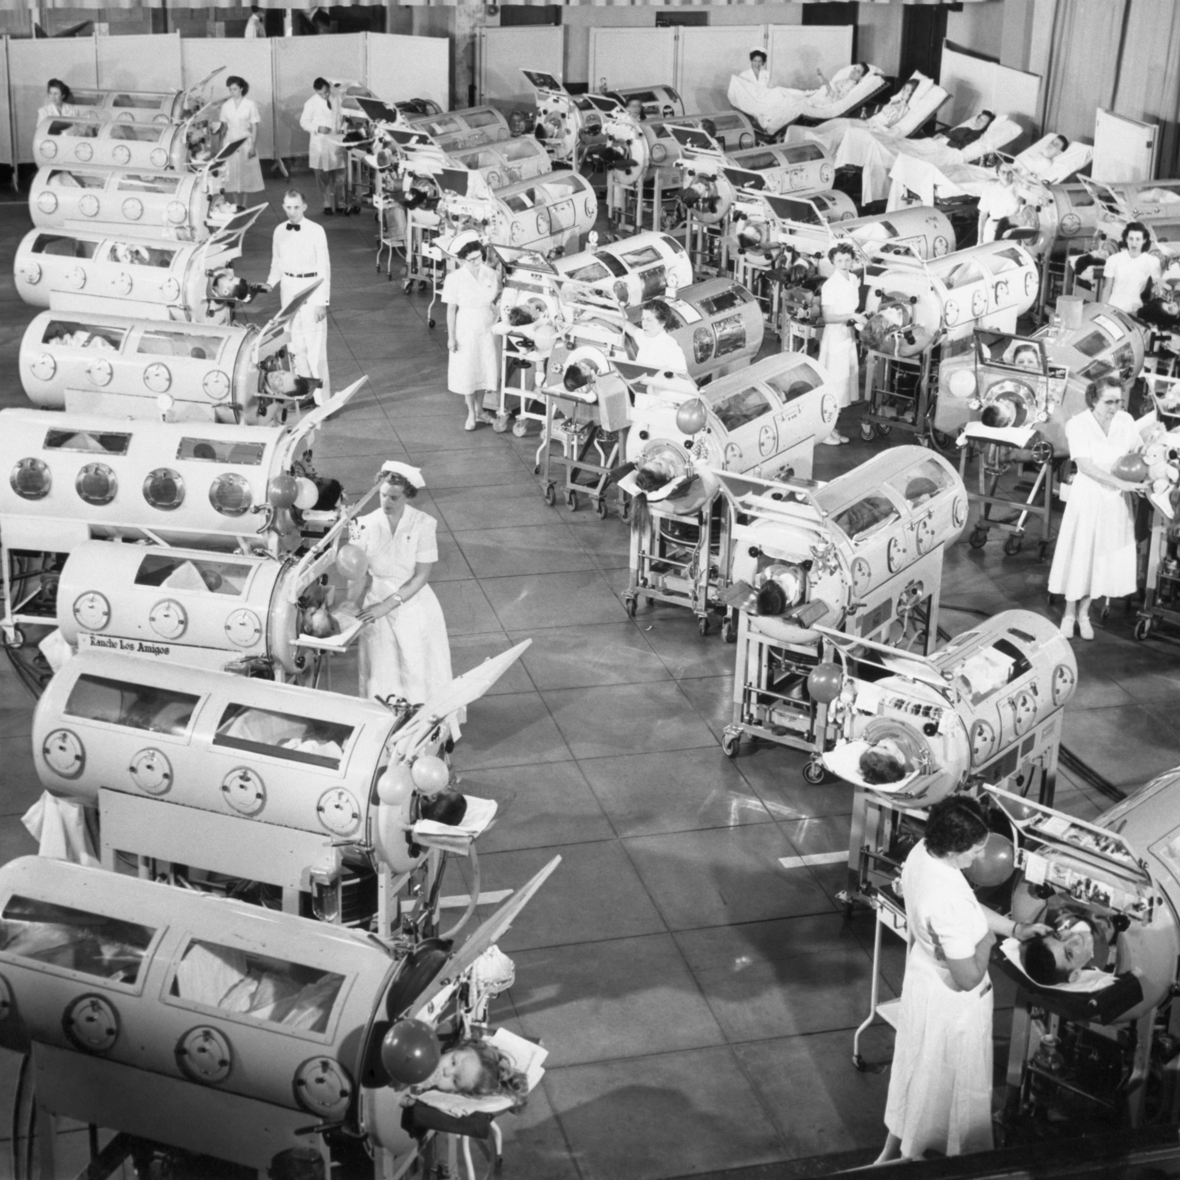
History
First major documented polio outbreak in the U.S. occurred in 1894.
In 1955, Dr. Jonas Salk a vaccine developed a vaccine.
Widespread use of polio vaccine starting in 1955.
The last case of naturally-occurring polio in the U.S. was reported in 1979.
Polio was declared eliminated in the U.S. in 1994.
Polio cases are still rarely reported in the U.S.
In 2022, case reported in New York.
Source: https://my.clevelandclinic.org/health/diseases/15655-polio; Photo: Credit: Science History Images / Alamy Stock Photo
Notes:
First major documented polio outbreak in the U.S. occurred in 1894, with outbreaks throughout the 1900s paralyzing and killing thousands of people.
In 1955, a vaccine developed by Dr. Jonas Salk is declared safe and effective.
Widespread use of polio vaccine starting in 1955 greatly reduced poliovirus infections over the next decade, with only 62 cases reported in 1965.
The last case of naturally-occurring polio in the U.S. was reported in 1979.
Polio was declared eliminated in the U.S. in 1994.
Polio cases are still rarely reported in the U.S., usually as a result of international travel.
Polio could come back in the U.S. if vaccination rates drop too low.

Slide 4
PolioPlus
What’s up with the “plus”?...
Launched in 1985, PolioPlus with an initial fundraising target of $120 million.
At that time, polio paralyzed 1,000+ children every single day in 125 polio-endemic countries.
Founding partner of the Global Polio Eradication Initiative; has reduced polio cases by 99.9%

Slide 5
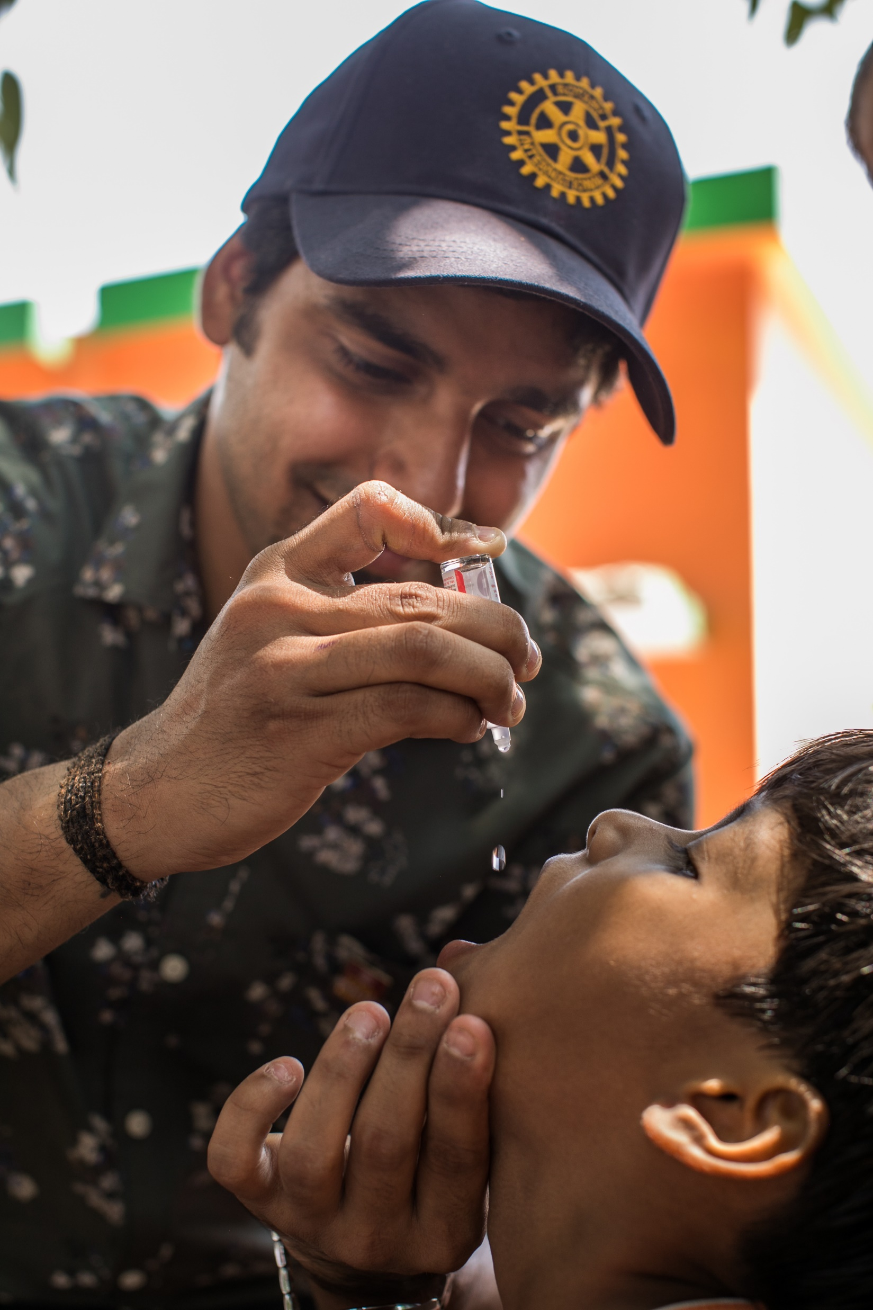
ROTARY’S EFFORTS:
Working to eradicate polio for > 35 years.
Rotary members have contributed > $2.1 billion + countless volunteer hours to protect nearly 3 billion children in 122 countries.
2023: endemic countries wild virus -- 5 cases in Afghanistan, 2 in Pakistan.
Over past 10 years, 10 B doses given, fewer than 800 cases of VDPV. Without vaccinations, more than 6.5 M children would have been paralyzed by wild poliovirus.

Slide 6
CURRENT STATUS:
Polio is only endemic in two countries (Pakistan & Afghanistan).
If all eradication efforts stopped today, within 10 years polio could paralyze as many as 200,000 children each year.

Slide 7
TOGETHER, WE
END POLIO
One Day. One Focus: Ending Polio
October 24, 2023
World Polio Day Resources
Action Ideas
Register Your World Polio Day Action
www.endpolio.org/world-polio-day

Slide 8
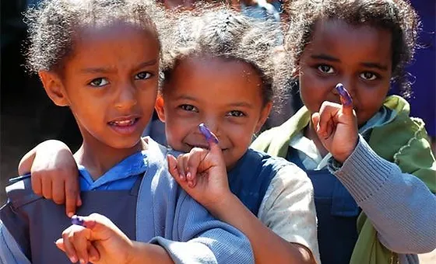
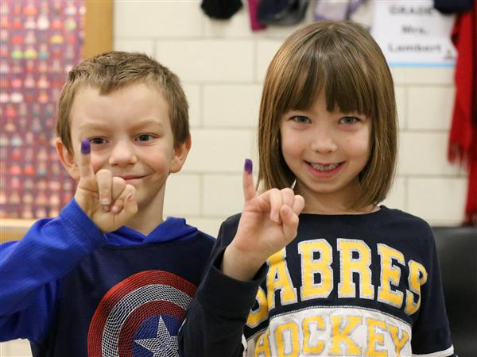
PURPLE PINKIES:

Slide 9
What can you do?
Donate:
Every donation helps us obtain the vaccines, transport, and materials needed in the fight against polio.
Your donation is worth triple: Donations are matched 2:1 by the Gates Foundation.
$3: The average cost to fully protect a child against polio.
Join the PolioPlus Society – commit to donate $100 per year
Learn: Get informed and help make polio a subject of conversation in your community. Visit EndPolio.org to learn more.
Share: Most people don’t know that polio still affects children around the world. Help spread the word!

Slide 10
Is your district/club looking for an easy way to fundraise for PolioPlus?
Iis
Annual donation to the PolioPlus Program of $100 per year
Notes:
It is a great way to create awareness and fundraise for Polio!!

Slide 11
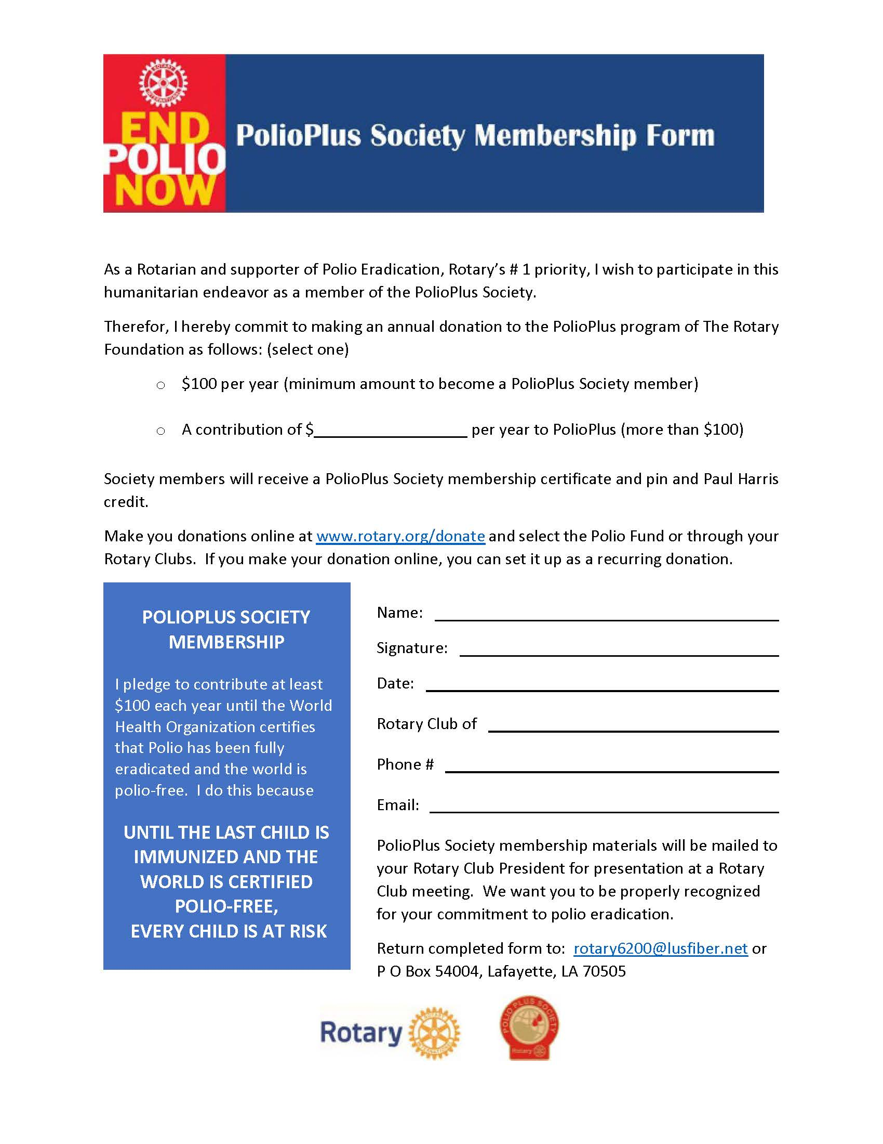
PolioPlus Society Membership Form

Slide 12
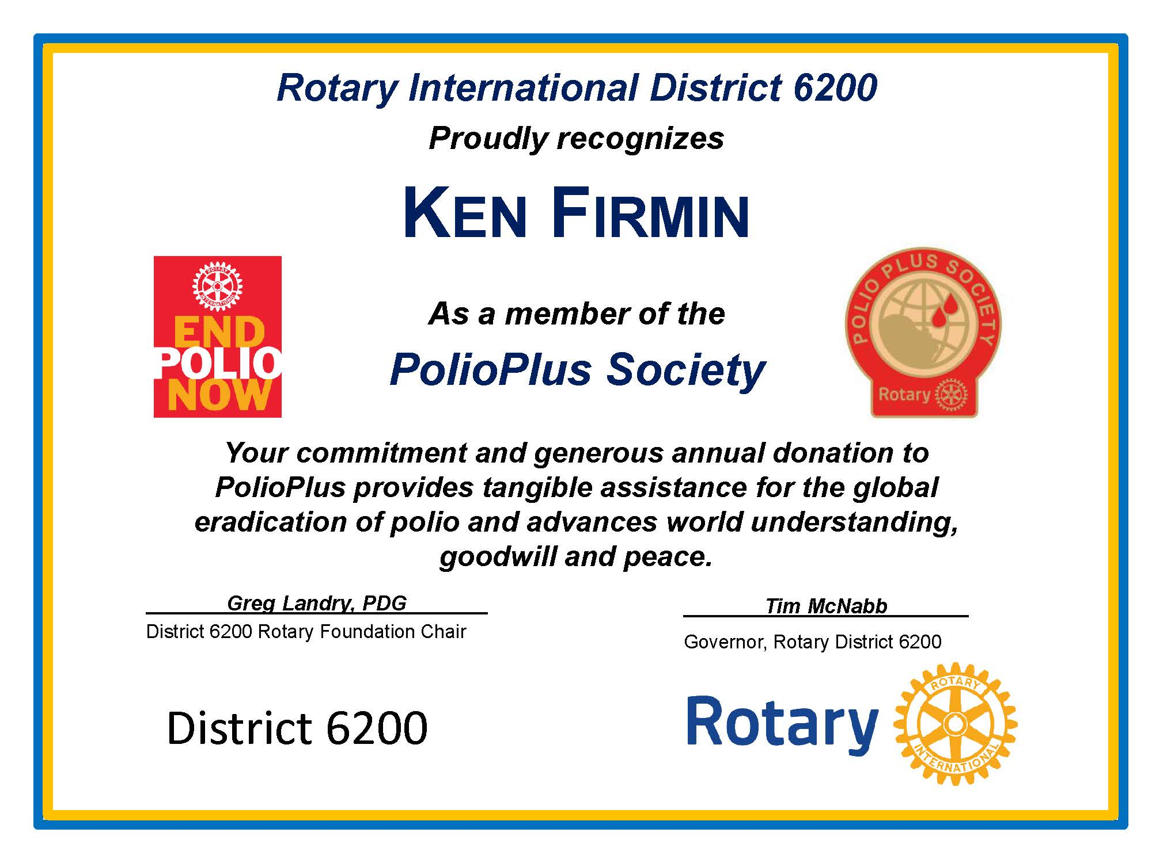

Slide 13
area of focus:
Disease prevention and treatment

Slide 14
THANK YOU for doing good in the world
Notes:
In closing, I just want to thank you all so much for the good work that you do in the world and the good work that you make possible by investing in your Rotary Foundation. I will be available to answer any questions that you might have at the end of today’s event.

